Slide 1
Financial Statement Analysis
R.Sriharinandan

Slide 2
INTRODUCTION
Financial Statement Analysis refers to the process of examining a company's financial statements such as balance sheet, income statement, statement of cash flows in order to assess if it is financially sound and it can also be used to compare its performance over a couple of years.
1
Ratio Analysis forms a key part of FS Analysis and is often used by many stakeholders to assess whether a company is doing well in terms of financial position.
2
These ratios can be categorized into several categories such as liquidity ratios, leverage ratios ,turnover ratios, profitability ratios and so on.
3
The financial ratios of companies can be compared or we can use these ratios to compare the year-on-year changes in these ratios for the company which can be used by all the stakeholders
4

Slide 3
OBJECTIVE
Automate the ratio calculation of companies over a period of two years as well as to create a dashboard that provides these ratios(year on year changes) in the form of a bar plot. This project also involves a brief process of EDA wherein we compute the shape, size and so on of the dataset in question.
PROBLEM STATEMENT
Manual Ratio Calculations and the subsequent process of visualizing trends is time consuming. Automating this process can potentially help stakeholders to make quick and informed decision about the company in question.
STEPS
Data Source
Basic EDA
Financial Ratio calculation(CY)
Financial Ratio calculation(PY)
Dashboard for visualization
The data required for the project has been acquired directly from the company's published financial statements which follow the INDAS (Indian Accounting Standards) and these websites are listed below
HUL - https://www.hul.co.in/files/annual-report-2023-24.pdf
ITC - https://www.itcportal.com/about-itc/shareholder-value/annual-reports/itc-annual-report-2024/pdf/ITC-Report-and-Accounts-2024.pdf
Nestle - https://www.nestle.in/sites/g/files/pydnoa451/files/2024-06/Annual-Report-2023-24.pdf

Slide 4
HINDUSTAN UNILEVER LIMITED (HUL)
Hindustan Unilever Limited (HUL) is one of India's largest fast-moving consumer goods (FMCG) companies
HUL operates over 50 brands across categories like personal care, home care, food, and beverages.
HUL has witnessed consistent increase in its financial position in terms of increase in revenue year on year.
HUL has adopted a conservative strategy in terms of its debt which resonates with its main competitor ITC.
The ratios have been computed and displayed for HUL
BASIC EDA
FINANCIAL RATIOS
Dataset Shape
Identifying Missing Values
Summary Statistics
Checking Data Types
These functions are performed by the Basic Class which involves a main function which calls on all the other function and this has been created into a module called as Basic which can then be used for automation to any database
The Financial Ratios Module computes financial ratios for the Current Year (CY) and Previous Year (PY).It extracts data from an excel file(balance sheet, income statement and statement of cash flows.
In this particular module, market price per share and number of shares outstanding are assumed to be exogeneous variables which require user inputs and as done in the previous module , the main function() calculates and returns financial ratios.

Slide 5
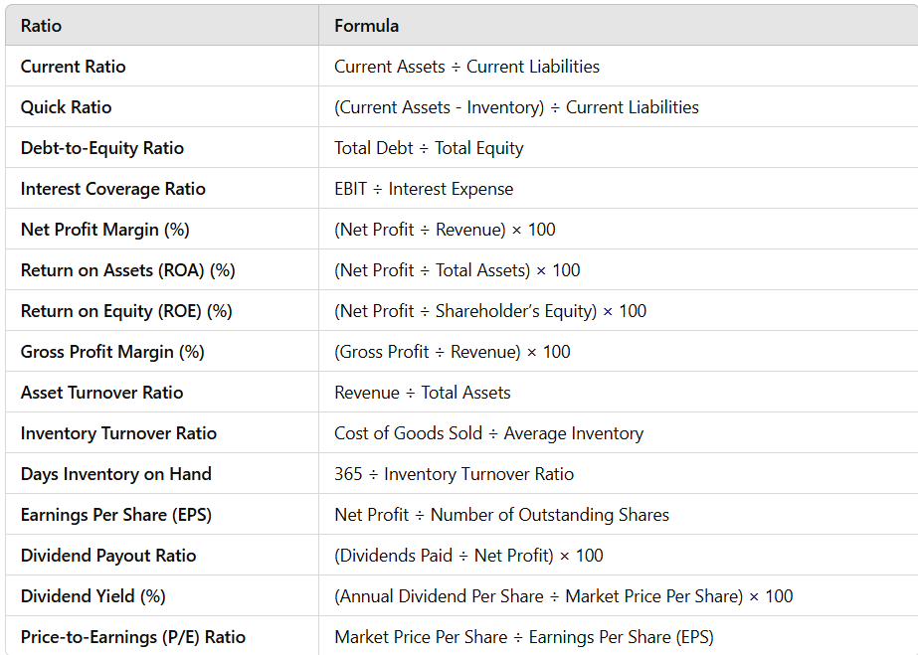
Formulas

Slide 6
BENCHMARK MODULE
The Financial ratio benchmark module establishes reference benchmarks to assess a company's financial health using key ratios. It includes Current Ratio, Quick Ratio, Net Profit Margin, ROA, ROE, Gross Profit Margin, Asset Turnover, Inventory Turnover, Days Inventory on Hand, Debt-to-Equity, EPS, Dividend Payout, Dividend Yield, P/E Ratio. Each ratio is compared against a predefined standard. Performance is classified as favorable or concerning, based on threshold values
DASHBOARD MODULE
An interactive financial dashboard using Dash and Plotly. The FinBoard class reads financial data from an Excel file and uses the Financial Ratios module to calculate key metrics for the current and previous year. It categorizes the ratios into liquidity, profitability, efficiency, leverage, and shareholder ratios, then generates bar charts to compare them. The dashboard layout is structured using Dash components, and executing dashboard.run_dashboard() starts a web application for financial analysis
INDUSTRY RELEVANCE
Financial Statement Analysis, which automates financial ratio analysis using Dash, has strong industry relevance. It streamlines financial assessment by enabling efficient company comparisons, benefiting investors, analysts, and finance professionals. The tool supports corporate decision-making, risk evaluation, and auditing by providing real-time insights with minimal manual effort. Additionally, its automation capabilities make it useful for FinTech applications, enhancing data-driven financial analysis and strategic planning.

Slide 7
THANK YOU

